Slide 1

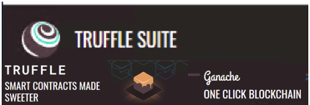
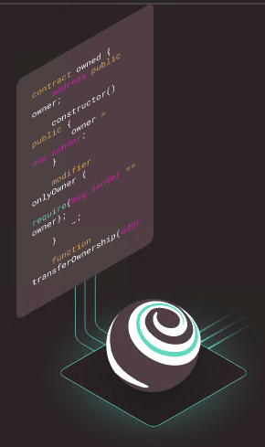

Creating Blockchain Distributed Apps Tools and Examples

Slide 2
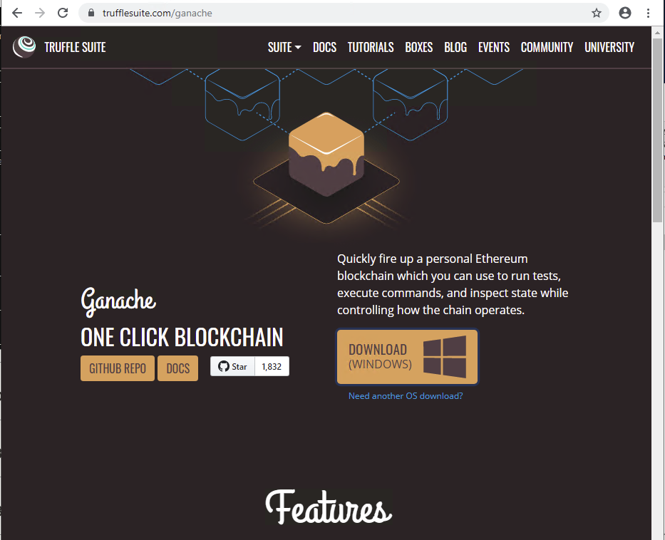
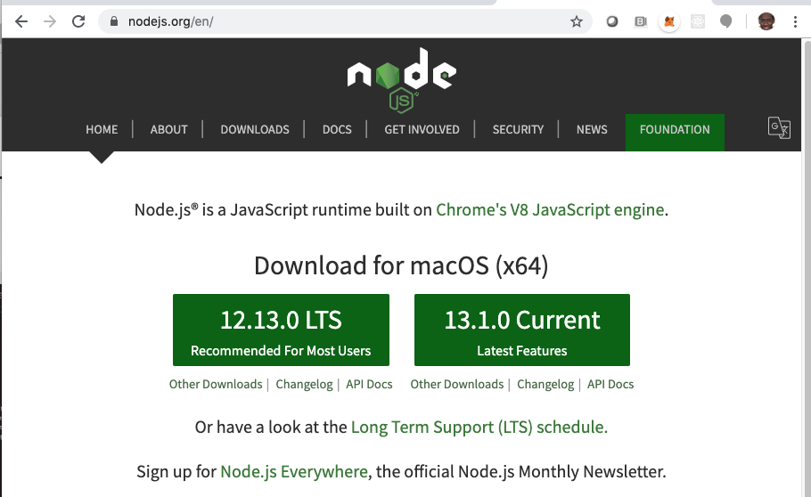
First Download Tools
https://nodejs.org/en/download/
https://www.trufflesuite.com/ganache

Slide 3
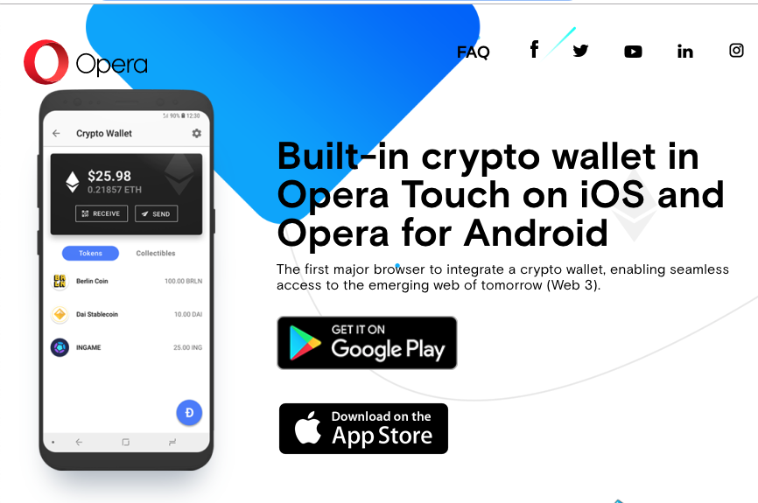
Optional Download Opera Phone App
https://www.opera.com/crypto

Slide 4
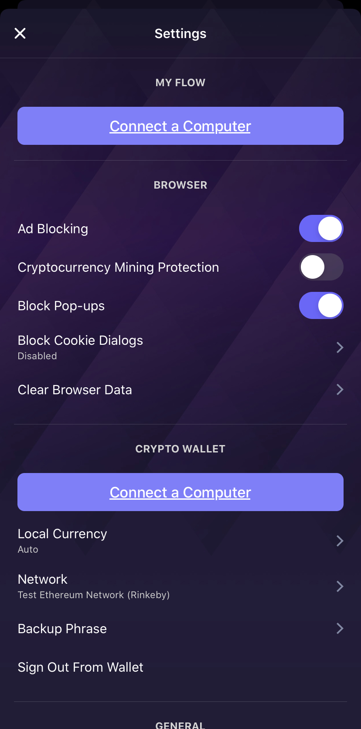
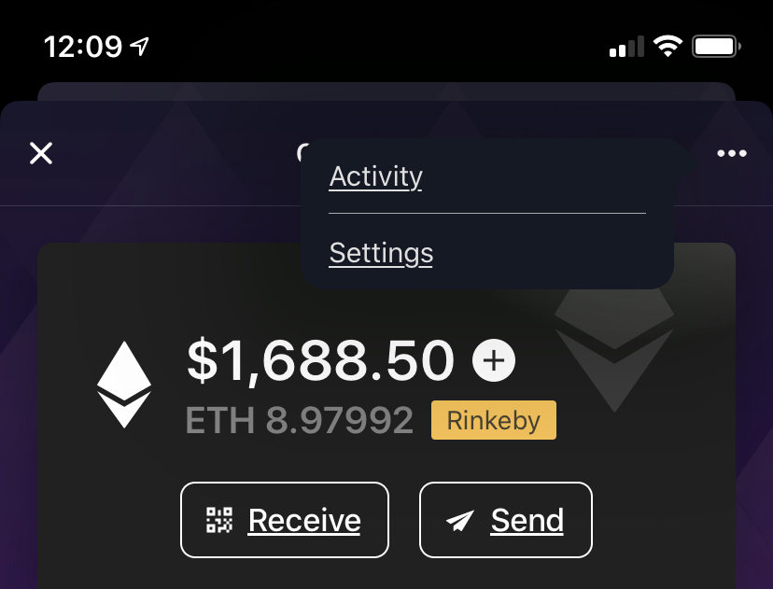
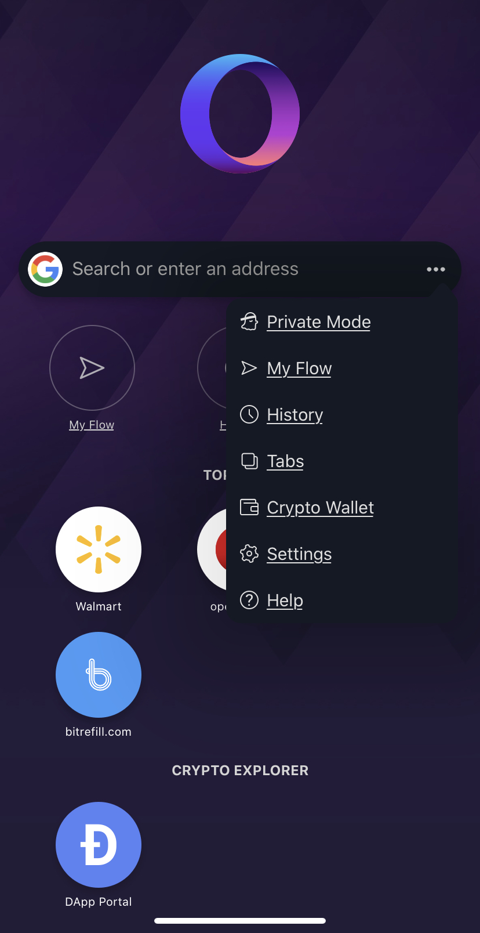
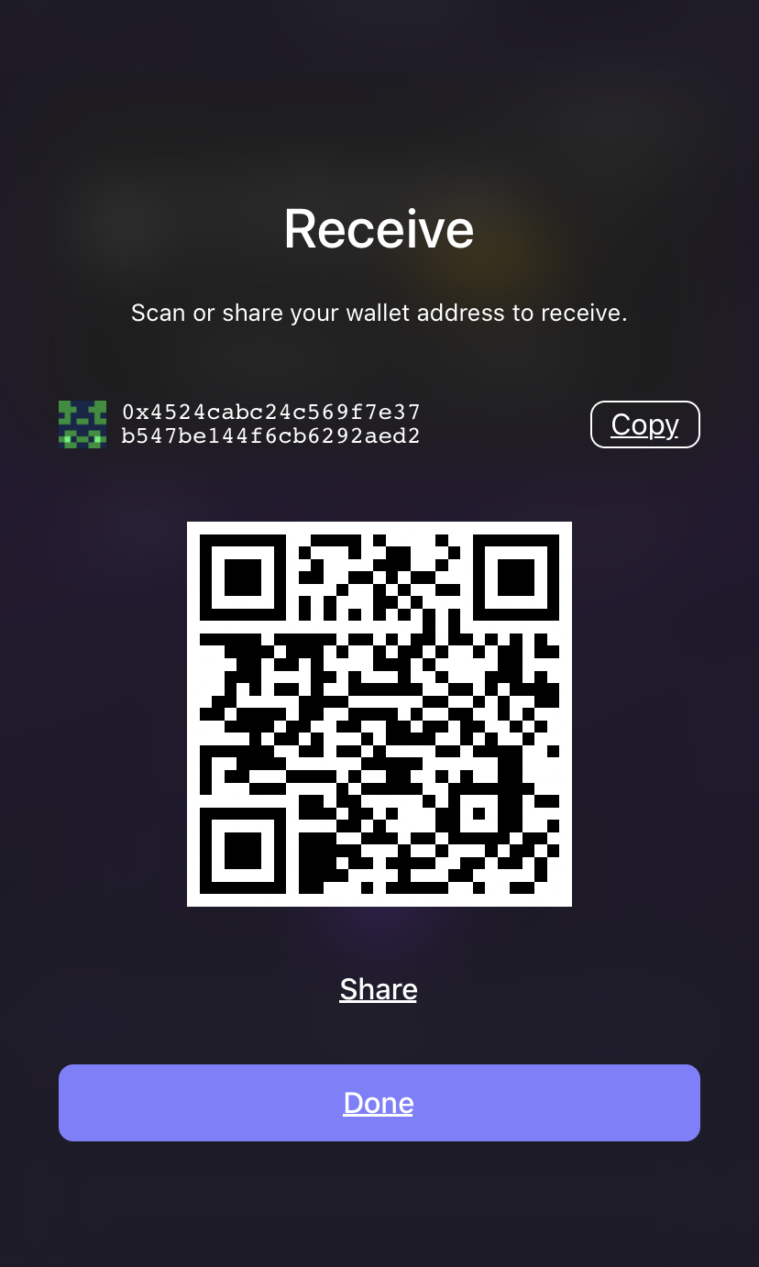
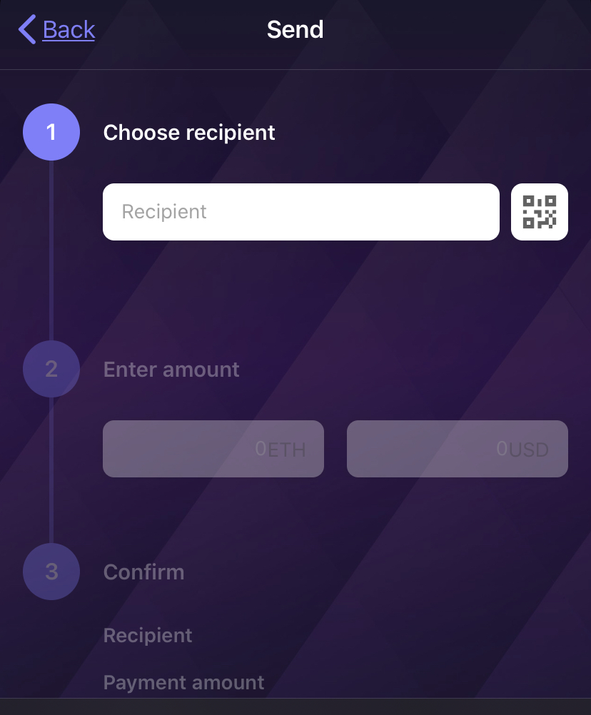
Optional Opera IOS Phone Wallet
You can test
With
Ethereum Rinkeby test network
Test Network
Rinkeby

Slide 5
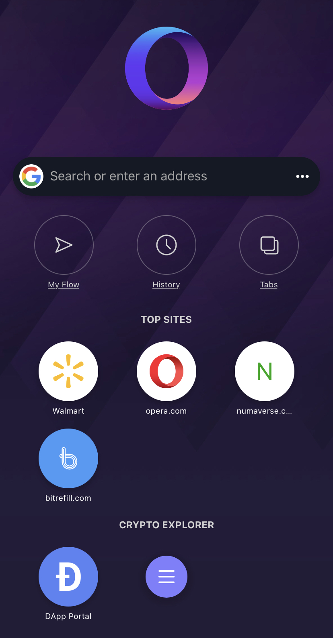
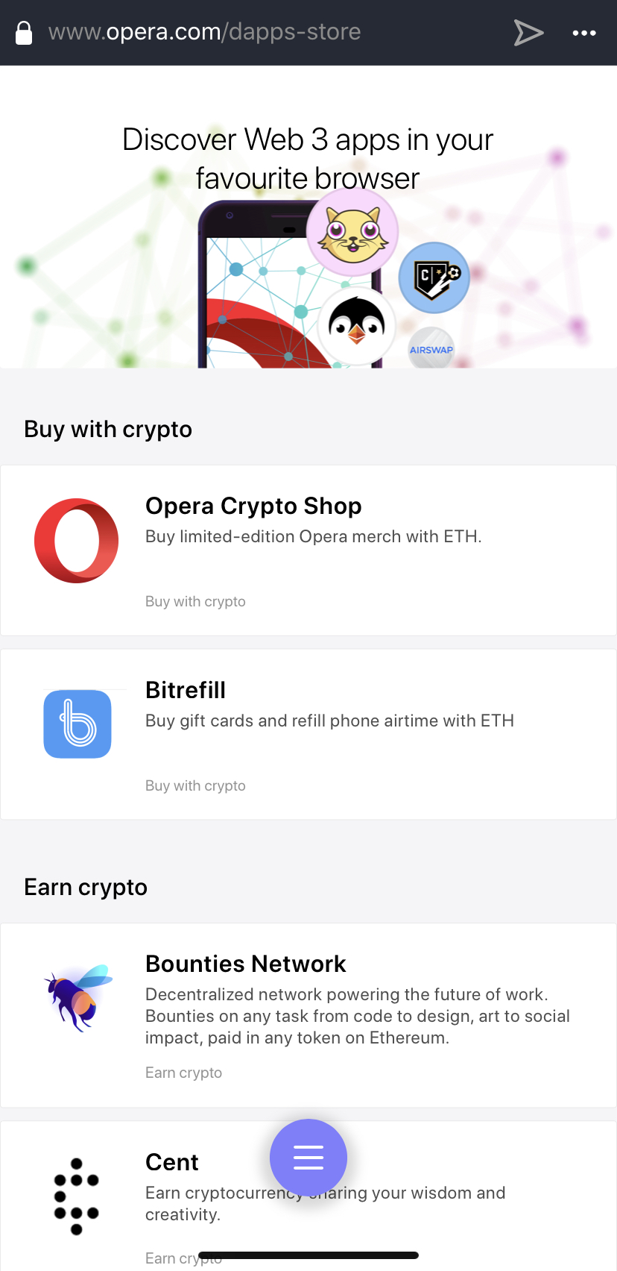
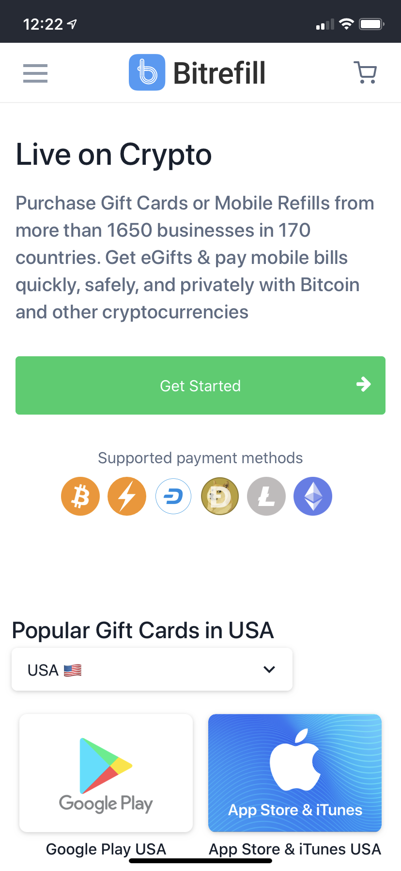
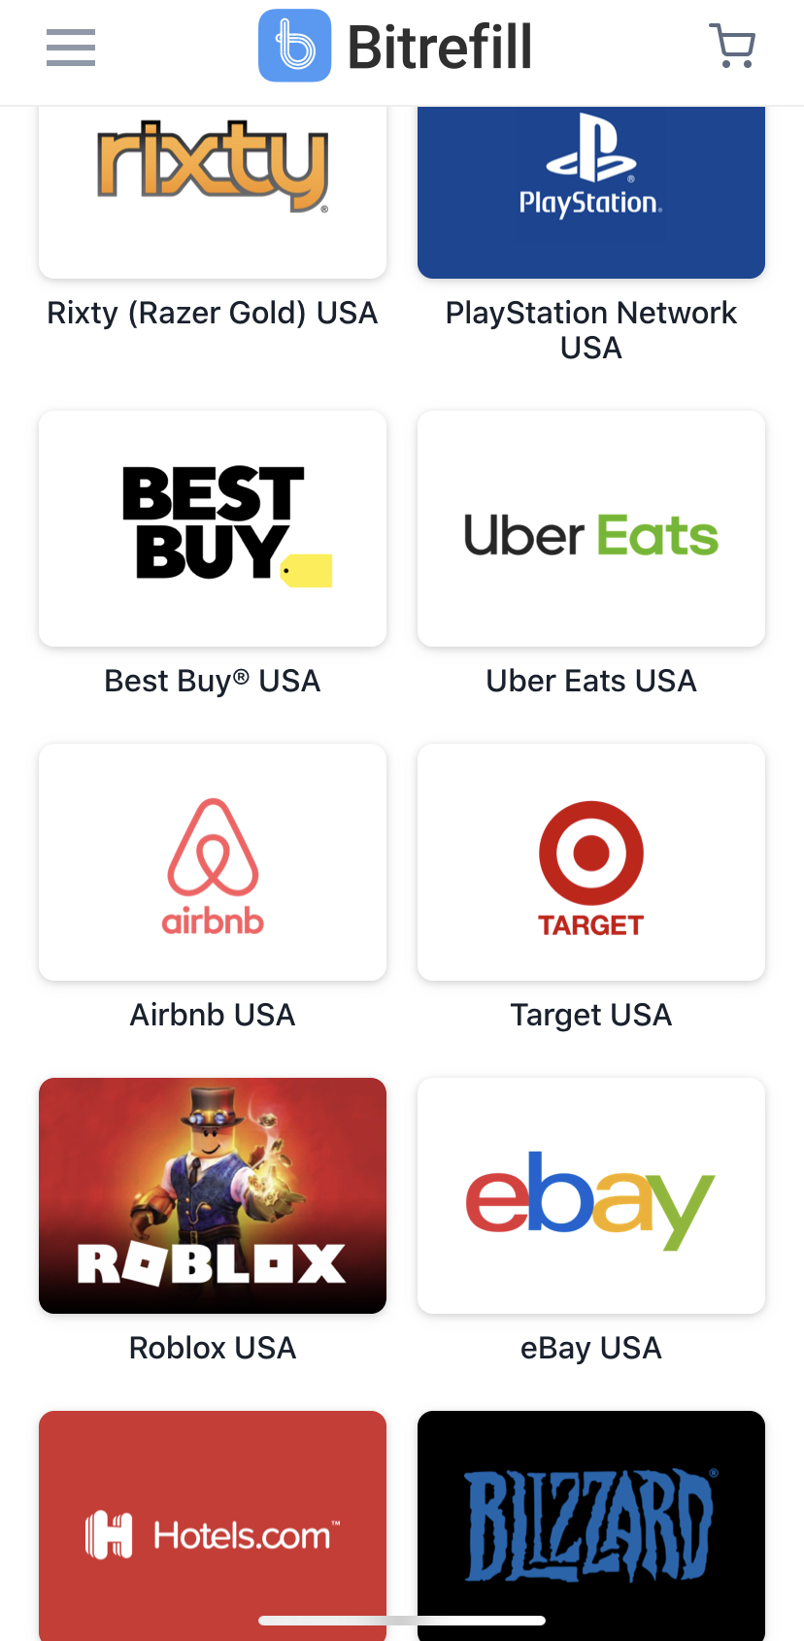
Optional Opera IOS Phone Wallet
Buy/’Sell
Dapps

Slide 6
Basic Blockchain Key Terms
Taken from: https://objectcomputing.com/expertise/blockchain/glossary
ETHEREUM
Ethereum is a decentralized Blockchain 2.0 chain. It was the first major smart contract platform and has widespread support from Fortune 500 companies through the Ethereum Enterprise Alliance (EEA). Ethereum currently uses a Proof-of-Work (PoW) consensus algorithm, but future changes to the protocol will update it to a more scalable algorithm, most likely based on Proof-of-Stake (PoS).
ETHER (ETH)
The base cryptocurrency for the Ethereum blockchain network. Ether is used as the currency to pay transaction fees to miners. It is stored on an account basis, rather than in Unspent Transaction Outputs (UTXOs). Ether's base unit is wei, and one ETH is equivalent to 1018 wei.
GAS
In the blockchain industry, a measure of the computational difficulty required to process a smart contract function. More complex functions use more gas. Gas can be hardcoded values for each opcode (as is the case for Ethereum) or subjective values based on the preferences of the miner (as is the case for EOSIO).
GAS PRICE
In the blockchain industry, the number of tokens that will be charged as a fee for each unit of gas consumed by a smart contract’s function. Gas prices allow a network to dynamically respond to changes in bandwidth demand based on market forces.

Slide 7
Basic Blockchain Key Terms
Taken from: https://objectcomputing.com/expertise/blockchain/glossary
BLOCKCHAIN
A method of storing data in discrete sections (blocks) that are linked together. Blockchains specify criteria for what data can be stored in a block and reject invalid data.
TOKEN – COIN – BITCOIN
In the blockchain industry, tokens are the generalized base unit of a cryptocurrency. A token is the lowest unit possible; it cannot be divided further.
CURRENCY
A system of abstract representations of the ability to reconcile debts that is generally accepted or in use. Money is a currency. In the United States of America, the U.S. Dollar is the national currency.
CRYPTOCURRENCY
Digitally distributed and traded currencies for which proof of ownership is established via cryptographic methods. For example, Ether cannot be transferred from an account without having control of the private key that is associated with that account.

Slide 8
Basic Blockchain Key Terms
Taken from: https://objectcomputing.com/expertise/blockchain/glossary
SOLIDITY
A smart contract programming language built for the Ethereum Virtual Machine. Syntactically it resembles C++ and Javascript and compiles to eWASM.
SMART CONTRACT
Code that is executable within the environment of a virtual machine. Blockchains use smart contracts in the context of the chain’s state to extend the functionality of the chain and provide trustless program execution. Smart contracts in blockchains are particularly useful because their outputs are deterministic, meaning anyone who processes a function in a smart contract will get the same output as anyone else performing the same function.
DAPP
A decentralized application. DApps operate similarly to regular web applications; however, they retrieve their state and data from a blockchain network (or multiple blockchain networks). DApps do not require a central web server to function and can communicate to each other over the messaging protocol of the blockchain network(s) to which they're connected.
DECENTRALIZATION
The movement of data, actions, and other interests away from a single actor in favor of distribution amongst all actors. In a decentralized system, no actor or group of actors can control the system without the consent of the rest of the actors.

Slide 9
Basic Blockchain Key Terms
Taken from: https://objectcomputing.com/expertise/blockchain/glossary
TRANSACTION
A singular input into a blockchain that affects some change in the blockchain’s data.
Depending on the blockchain’s implementation, transactions can transfer cryptocurrencies, create log events, or execute smart contract functions.
TRANSACTION FEE
An amount of cryptocurrency, typically a blockchain’s native cryptocurrency, that is charged by a miner to manipulate data on the chain. Transaction fees are generally variable and heavily dependent upon market conditions.
Example
If many transactions are being requested, and a limited number can be included in a block, a miner chooses to include whatever transactions have the highest profit margins, i.e., the transactions with the highest fees. Higher transaction fees can be set to incentivize miners to prioritize including a specific transaction in a block. In the reverse, if fewer transactions are being requested than will fit in a block, miners include all transactions that meet a minimum profitability requirement, and lower transaction fees can be set.
WALLET
A file or software that contains the private keys for interacting with a Private Key Infrastructure (PKI). Typical wallet software has functionality for signing messages and transactions for the corresponding network.

Slide 10
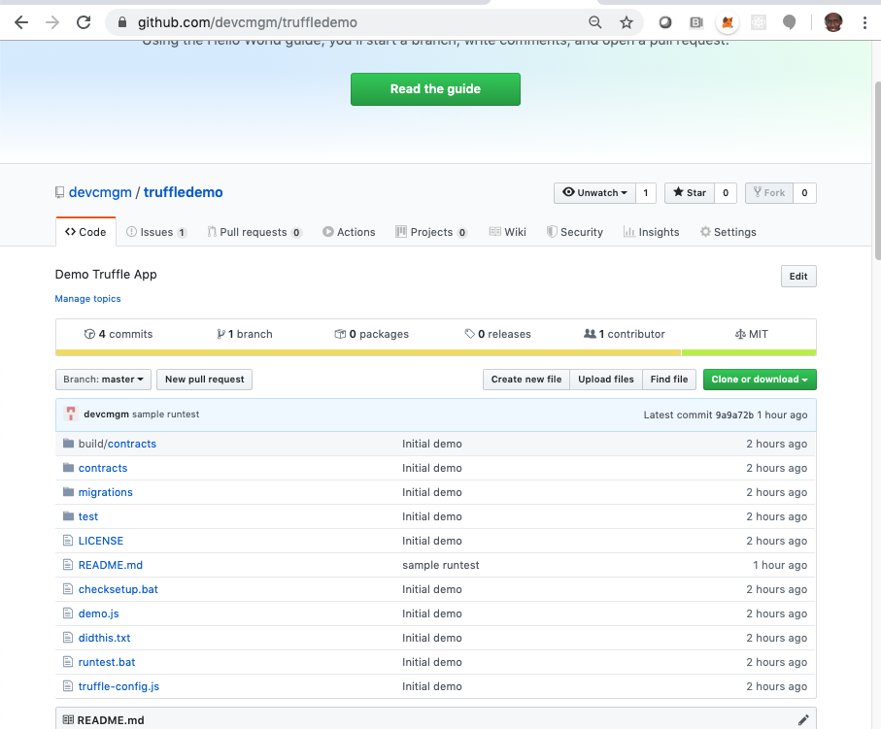
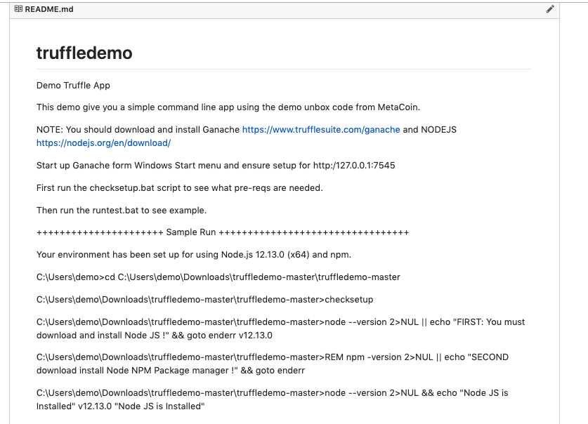
Simple Demo Code using MetaCoin
https://github.com/devcmgm/truffledemo

Slide 11
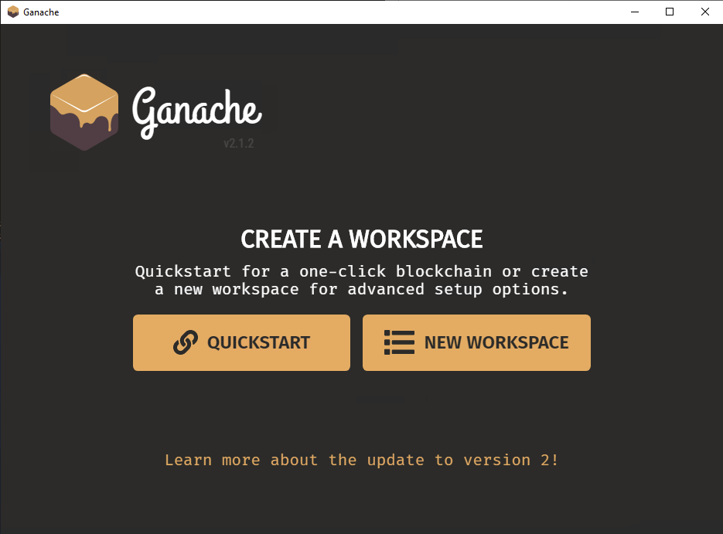
https://www.trufflesuite.com/ganache

Slide 12
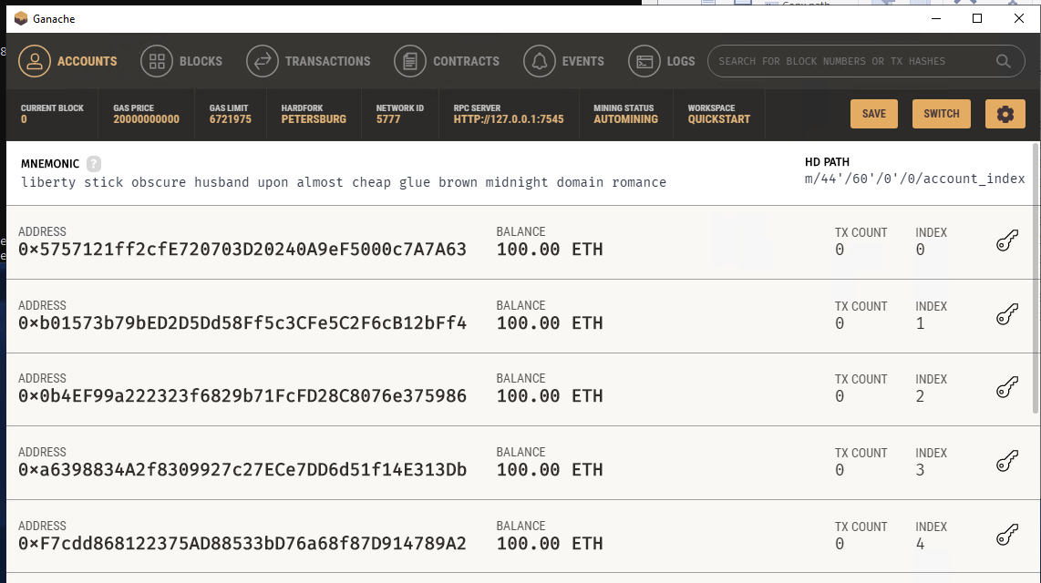

Slide 13
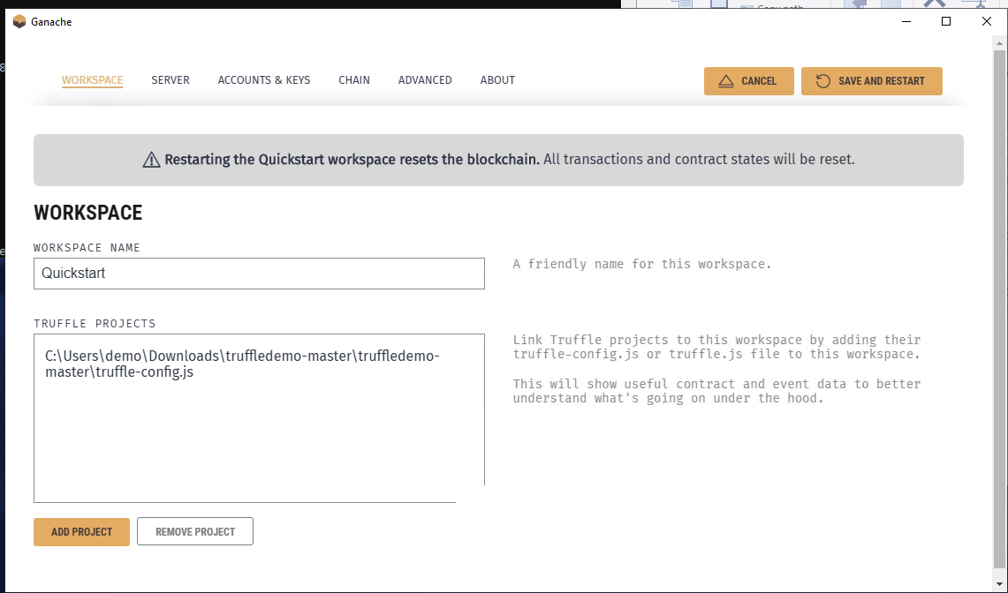
Load Contracts from config file

Slide 14
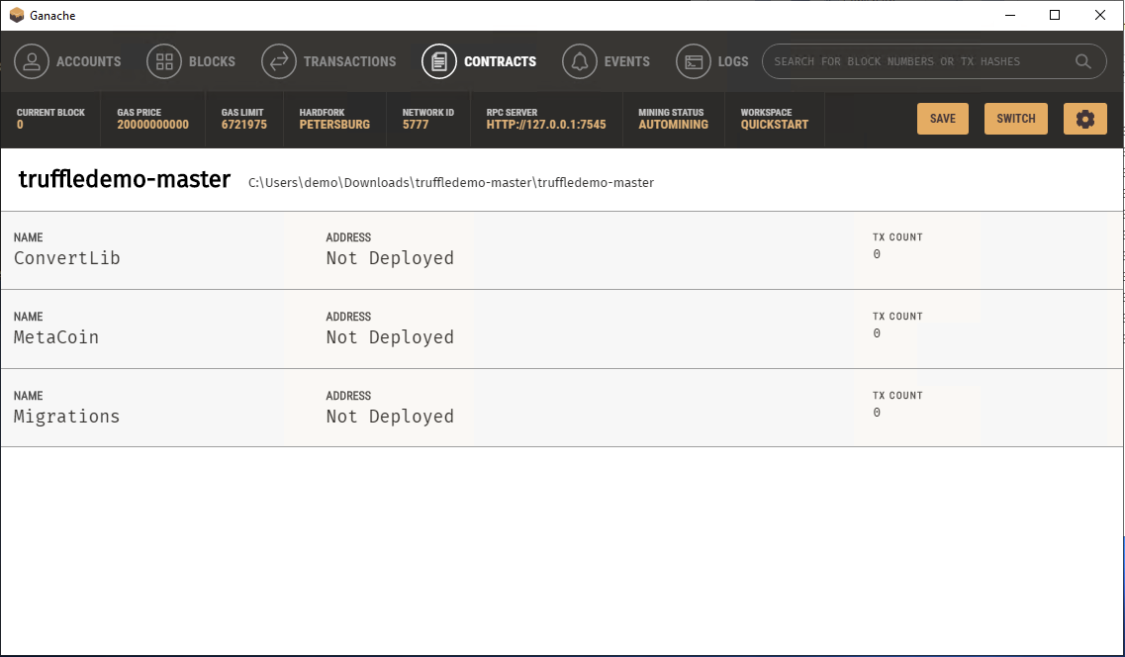

Slide 15
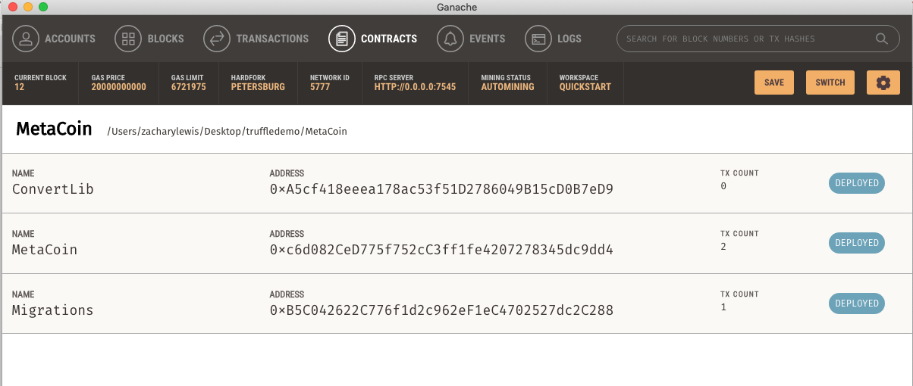
After truffle Migrate

Slide 16
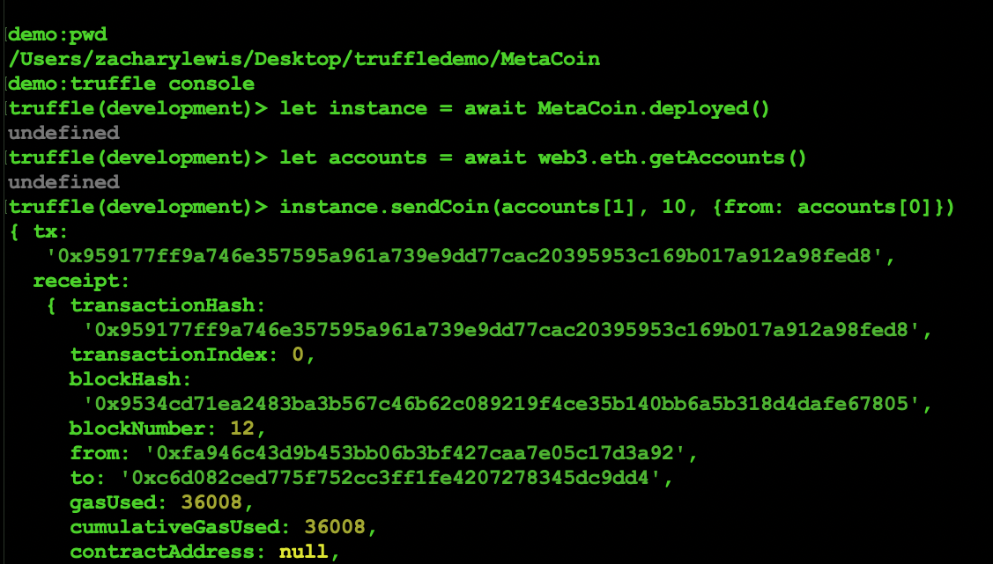
Perform a Send Coin Transaction

Slide 17
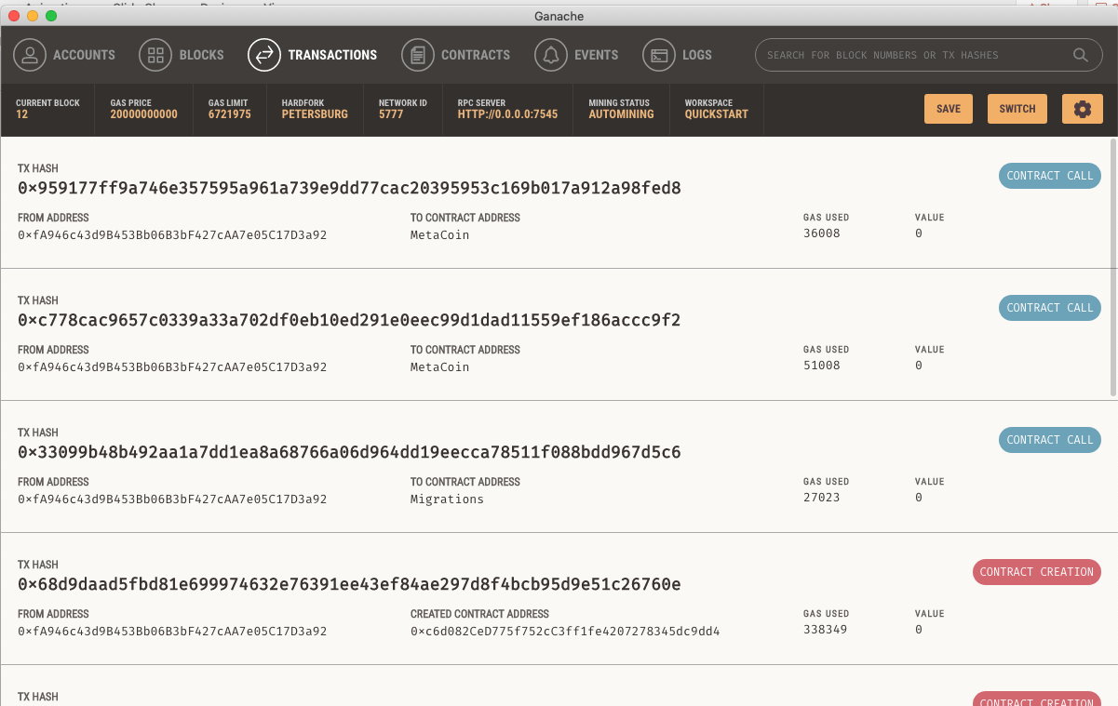

Slide 18
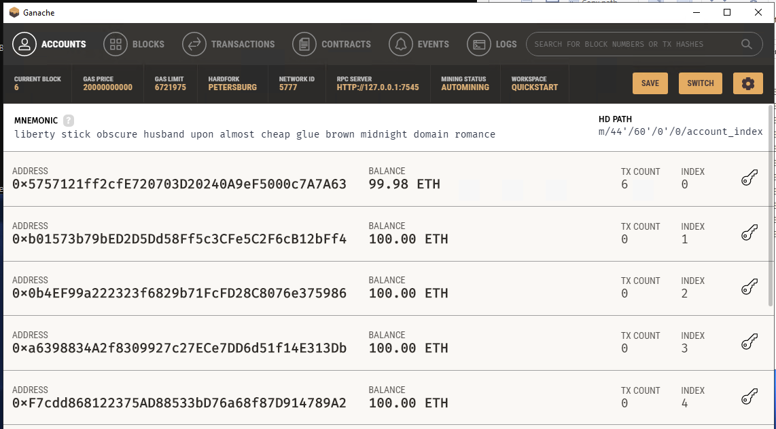

Slide 19
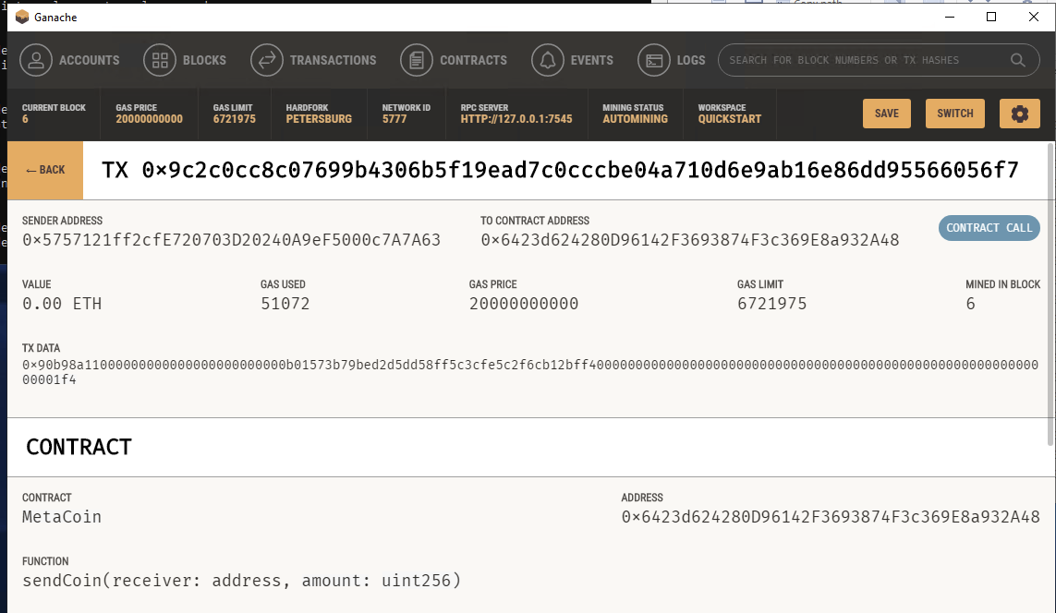

Slide 20
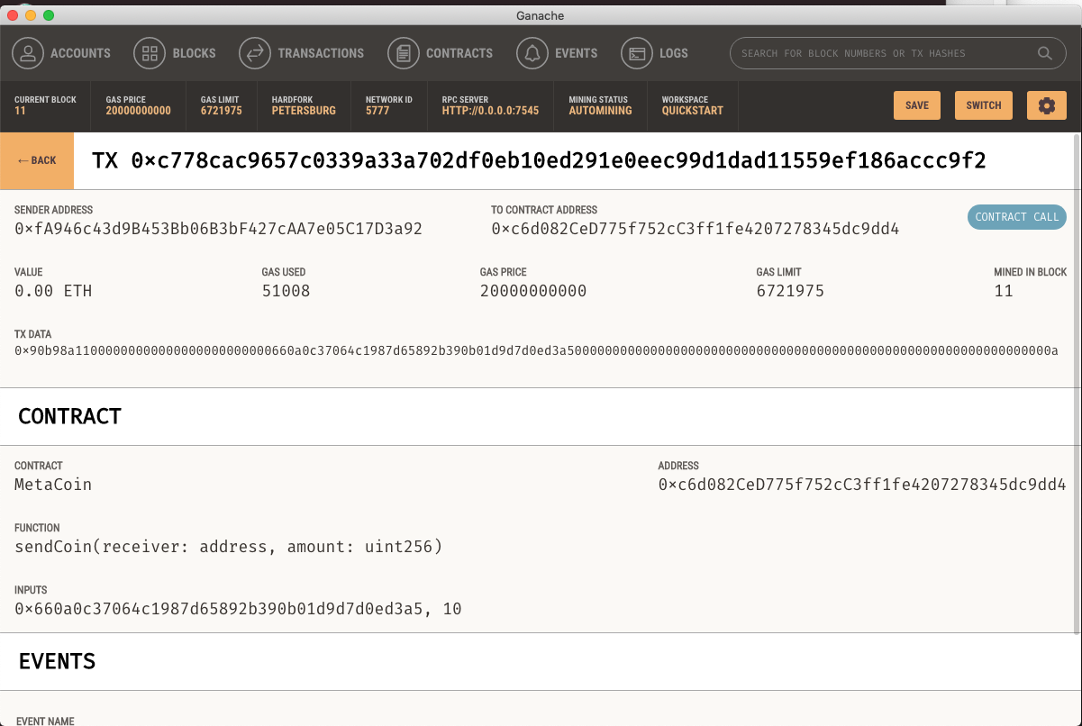

Slide 21
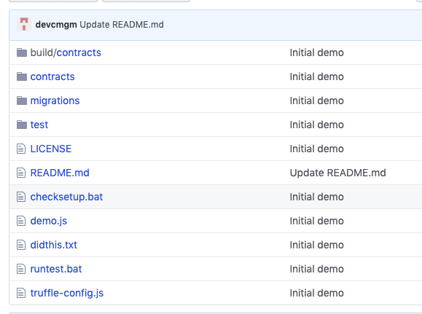
Sample Dapp File Layout

Slide 22
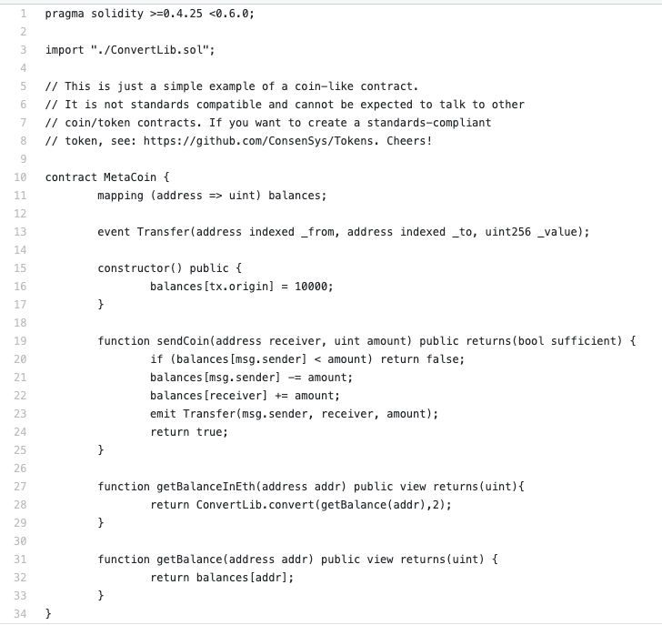
Solidity Code

Slide 23
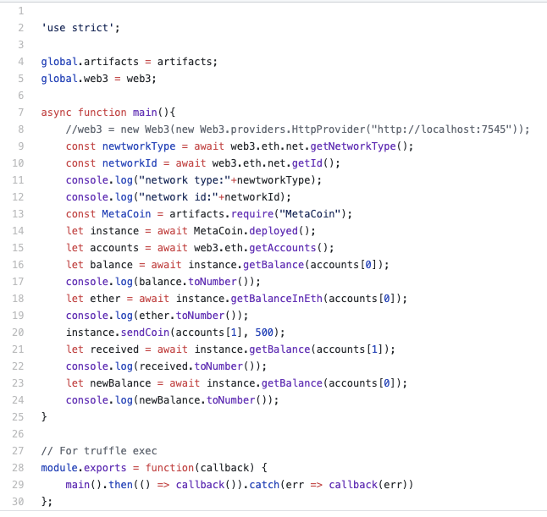
Command Line NODE Javascript DApp

Slide 24
https://www.trufflesuite.com/docs/truffle/getting-started/interacting-with-your-contracts
truffle unbox metacoin
Update: truffle-config
Truffle compile
Truffle migrate
Truffle console
https://github.com/trufflesuite/truffle/tree/master/packages/contract
.

Slide 25
Other Resources
https://ethereum.org/
https://www.trufflesuite.com/tutorials
https://www.dappuniversity.com/articles/the-ultimate-ethereum-dapp-tutorial
https://www.youtube.com/results?search_query=blockchain+tutorial
https://www.youtube.com/watch?v=2CRI0s6UPfA

